Slide 1
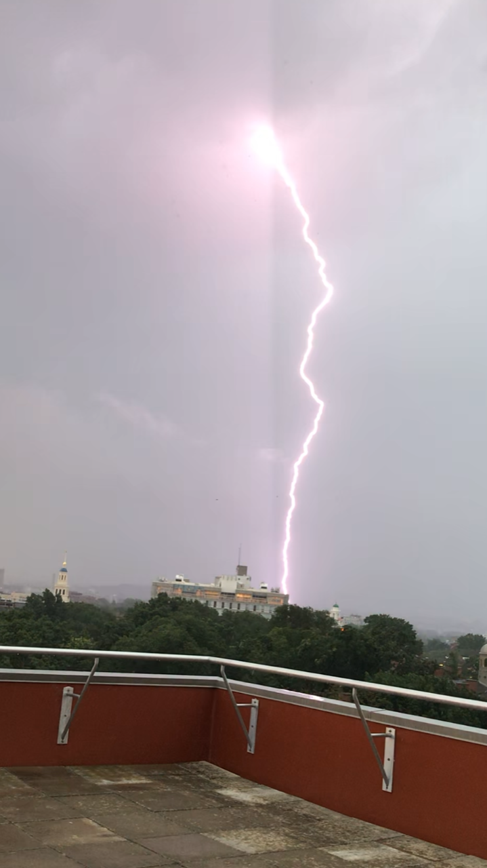
SCIENCE CENTER
POWER SHUTDOWN
INFORMATION
Science Center
Building Operations

Slide 2
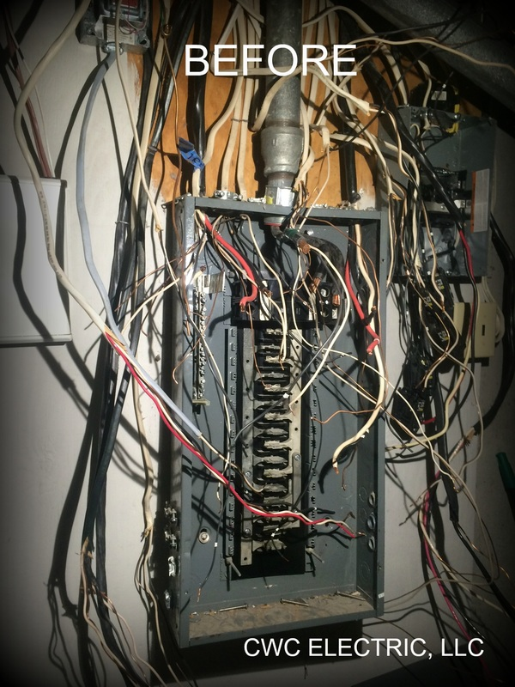
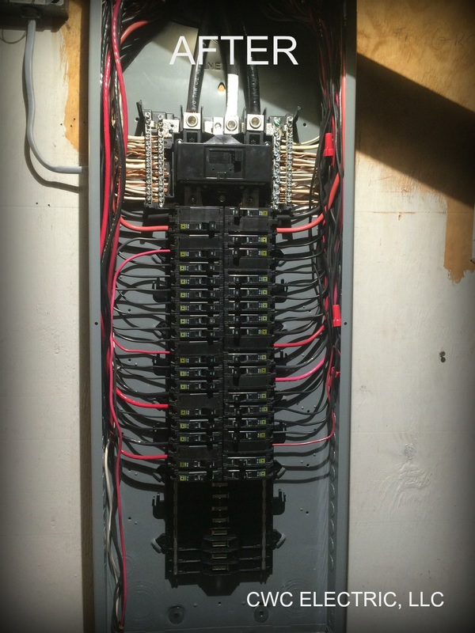
Agenda
WHY?
Project Scope
Schedule
What to Expect
Emergency and Life Safety Power
Q/A

Slide 3
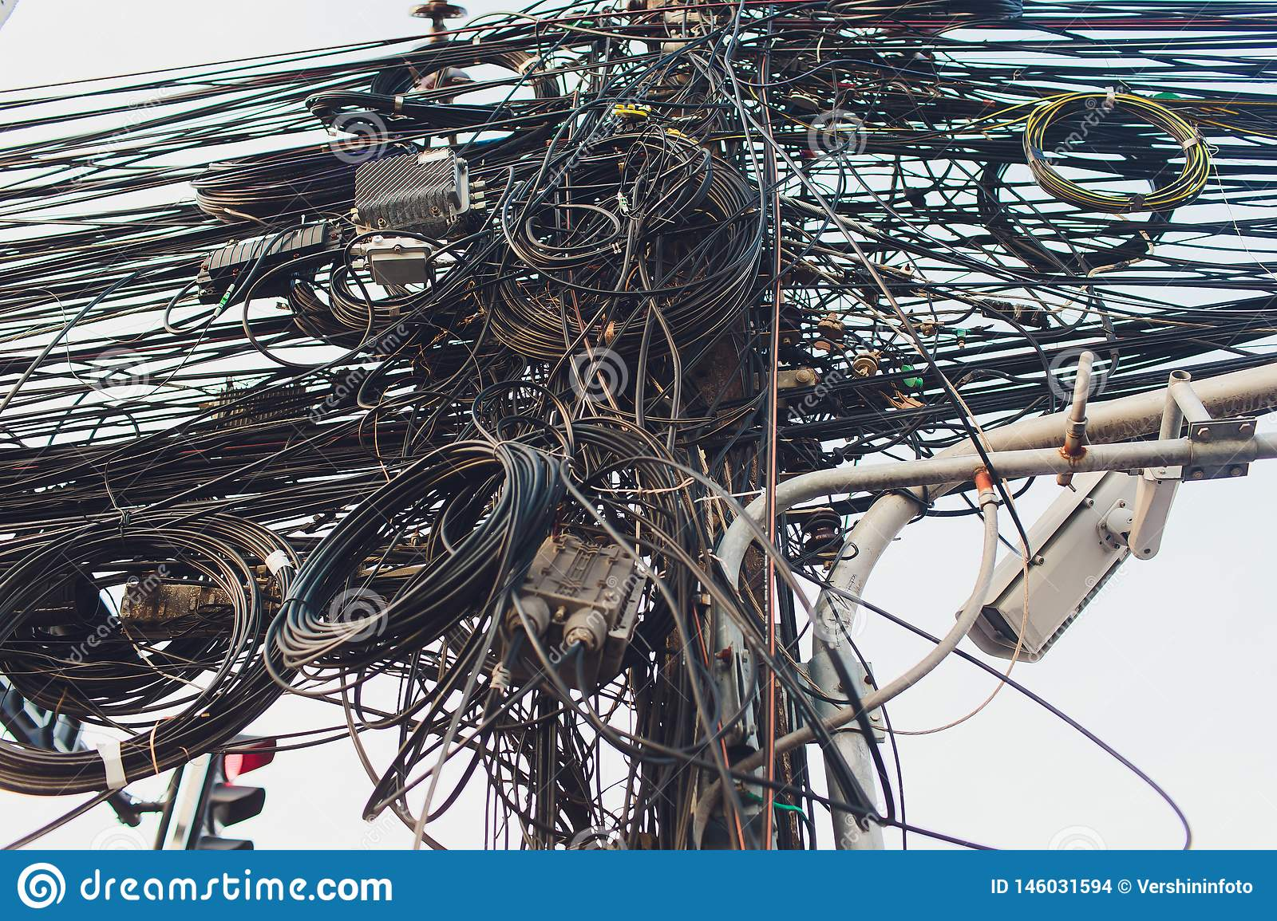
WHY
The Struggles of Legacy Wiring and Past Projects.
Which wire is the copier outlet???
We need to shutdown the power to the library!
We need to shut off power for the fan motor replacement

Slide 4
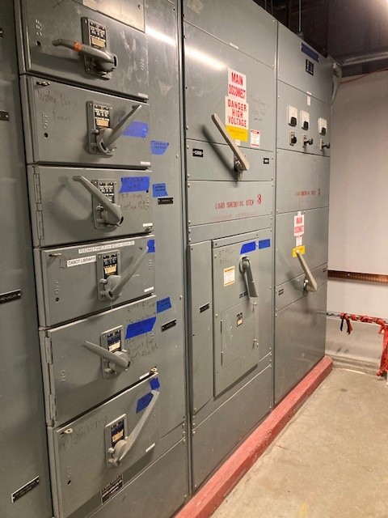
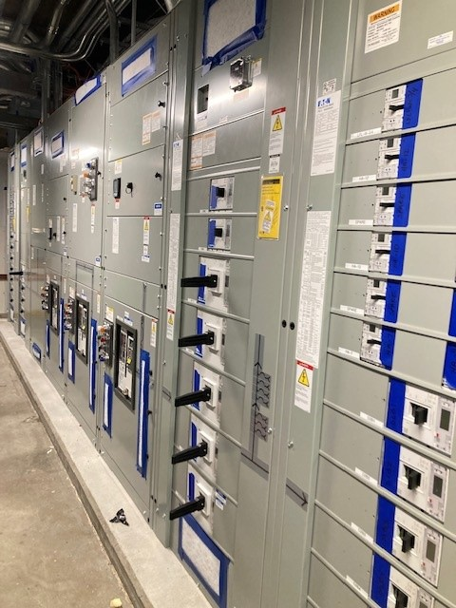
Project Scope
New Switch Gear
New Power Panels
Clean up legacy wiring
Reconfigure Circuits
More Efficient Power
More Reliable Power

Slide 5
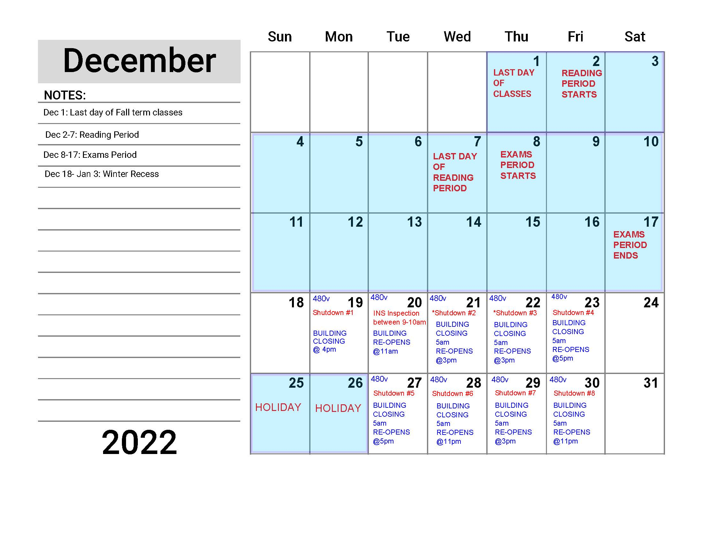
Schedule
December

Slide 6
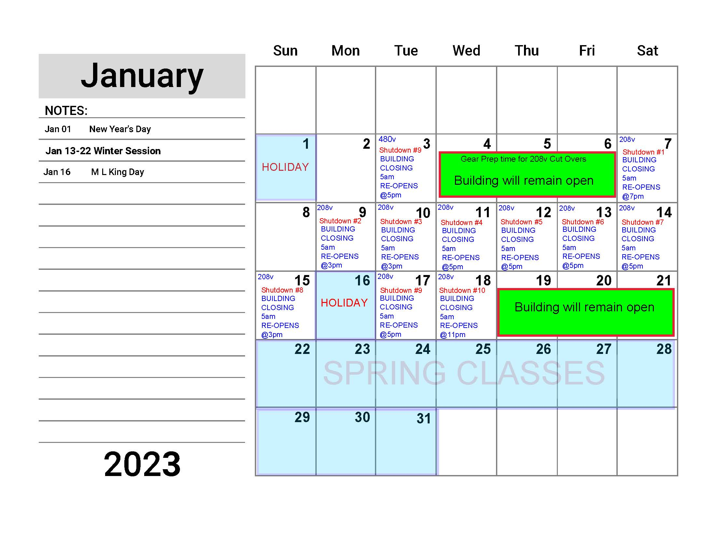
Schedule
JAnuary

Slide 7

Thank you All

